Slide 1
Principles of Marketing
8th edition
Chapter 7
Products, services and brands: Offering customer value
Copyright © 2021 Pearson Australia (a division of Pearson Australia Group Pty Ltd)
9781488626203/Armstrong/Principles of Marketing, 8e

Slide 2
What is a product?
A product
is anything that can be offered to a market for attention, acquisition, use or consumption that might satisfy a want or need.
A good
is a physical object that can be perceived by touch such as a building, vehicle, or gadget.
Tangible good – things you can pick up or touch, and own.
A service
is an activity, benefit or satisfaction offered for sale that is essentially intangible and does not result in the ownership of anything.
Intangibles – things that are done by or for the consumer - services, experiences, events, people, places, properties, organisations, information and ideas

Slide 3





What is a product (market offering)?
Goods
Services
Ideas: political marketing, social ideas e.g. Universities
…. but ‘services’ can be extended to include ideas, events, people and places
Place: tourist destinations, heritage sites, parks & gardens eg Great Barrier Reef
Events/ experiences: festivals, cultural/sporting events eg AFL: Hawthorn beating Sydney round 23 August 2018
Person / celebrity: celebrities, artists, performers) eg Justin Timberlake

Slide 4
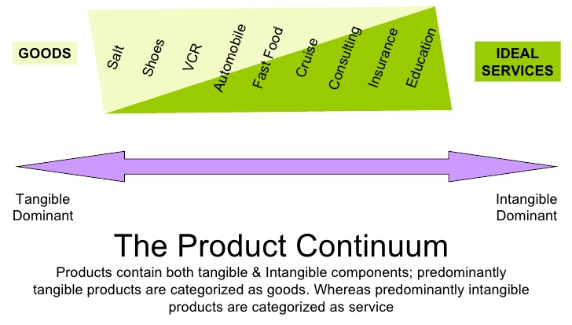
Products usually include both tangible and intangible components

Slide 5
What is a product?
To differentiate their offers beyond simply making products and delivering services,
Many companies are now creating and managing customer experiences with their brands or company.
Levels of products, services and experiences
Product planners need to think about products and services on three levels:
core customer value – the fundamental benefit or solution the product provides to satisfy the customer's need.
actual product – the tangible, physical product or service that delivers the core benefit
augmented product – the additional value-added services or benefits that enhance the product experience and differentiate it from competitors.

Slide 6
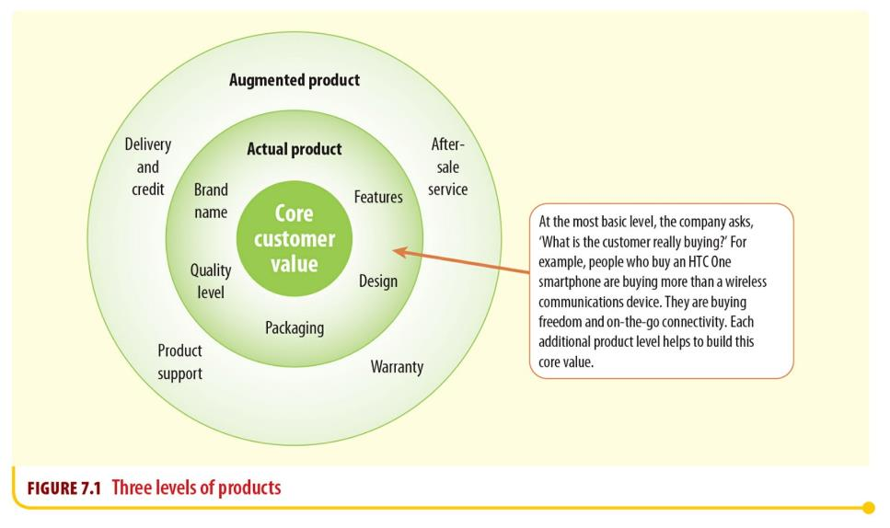
Three levels of products
Notes:
Diagram shows three concentric circles. The innermost circle is labelled as ‘Core customer value’.
The annulus between the inner circle and outer ring depicts the following five features of ‘Actual product’:
Features
Design
Packaging
Quality level
Brand name.
The outer ring depicts the following four features of ‘Augmented product’:
After-sale service
Warranty
Product support
Delivery and credit.

Slide 7
Example of core, actual & augmented: Qantas
Core Product – Key Features
Basic Need or Benefit: It's what the customer truly wants to gain (not the physical product).
Example: For a hotel stay, the core product is rest and sleep - not the bed or the room, but the benefit of comfort and relaxation.

Slide 8
Example of core, actual & augmented
Actual Product – Key Characteristics
Branding: Includes the name, logo, and identity associated with the product.
Design: refers to the appearance, style, and user-friendliness of the product
Quality: refers to how well the product performs its function and meets customer expectations, durability, materials, performance, etc.
Packaging: How the product is presented—important for perception and protection.
Functionality and Features: What it does and how well it does it.
Example: For a bottle of perfume, the actual product is the brand (e.g., Chanel), the bottle design, the scent, and packaging.

Slide 9
Example of core, actual & augmented
Augmented Product – Key Characteristics
Product Support, Extra Services and Benefits: These go beyond the physical product to improve customer satisfaction.
Customer Support: Helplines, service centers, online chat, etc.
Warranty or Guarantee: Provides assurance and builds trust.
Delivery, Credit and Installation: Makes the buying experience smoother.
Loyalty Programs or Freebies: Adds value and encourages repeat business.
Example: When buying a laptop, the augmented product might include a 2-year warranty, free antivirus for a year, and tech support.

Slide 10
What is a product?
Product and service classifications (cont.)
Consumer products
A consumer product is a product bought by final consumers for personal consumption.
Consumer products can be further classified, based on how consumers go about buying them, as:
convenience products
shopping products
specialty products
unsought products.

Slide 11
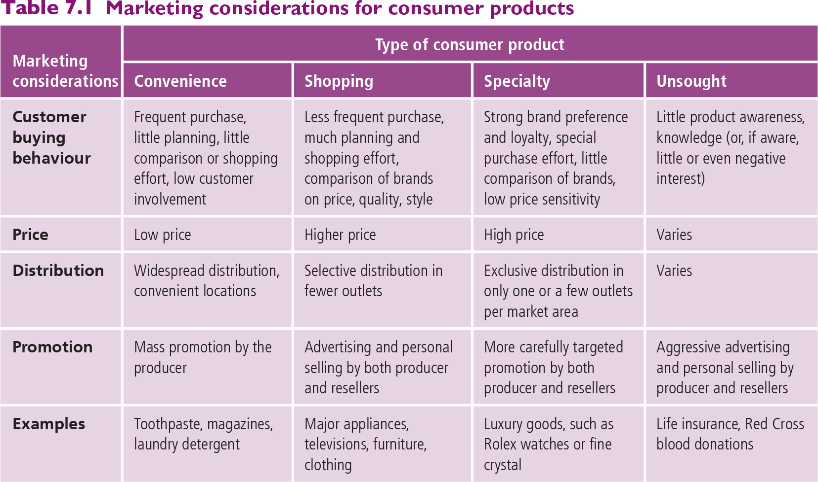
Marketing considerations for consumer goods

Slide 12
Involvement – the implications for marketing strategy
Involvement levels refers to the personal, financial, and social significance of the decision being made.
Low and high consumer involvement has important implications for marketing strategy
Factors determining the level of consumer involvement
Previous experience
Interest
Situation
Perceived risk
of negative consequences
Social visibility
High involvement
Should provide sufficient info
Personal selling to answer questions
Use comparative advertising
Provide intensive help/chat line
Simplify product benefits
Low involvement
Avoid stock out
Maintain product quality
Free samples to encourage trial that breaks brand habit
Develop ‘flashy’ ads that evoke desire/curiosity

Slide 13
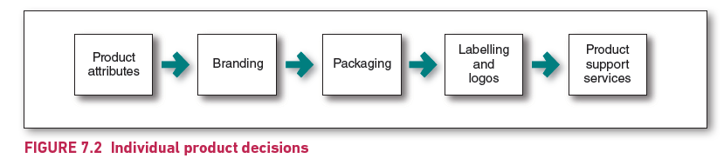
Product and service decisions
Individual product and service decisions
Figure 7.2 Individual product decisions

Slide 14
Product and service decisions
Individual product and service decisions (cont.)
Product attributes
Are the characteristics of a product or service that bear on its ability to satisfy stated or implied customer needs.
Quality has a direct impact on product or service performance and is directly linked to customer value and satisfaction.
Quality reflects the product's reliability, durability, and performance, ensuring customer satisfaction.
Two dimensions of product quality (fit for purpose):
Performance quality – the ability of a product to perform its functions.
Conformance quality – freedom from defects and consistency in performance

Slide 15
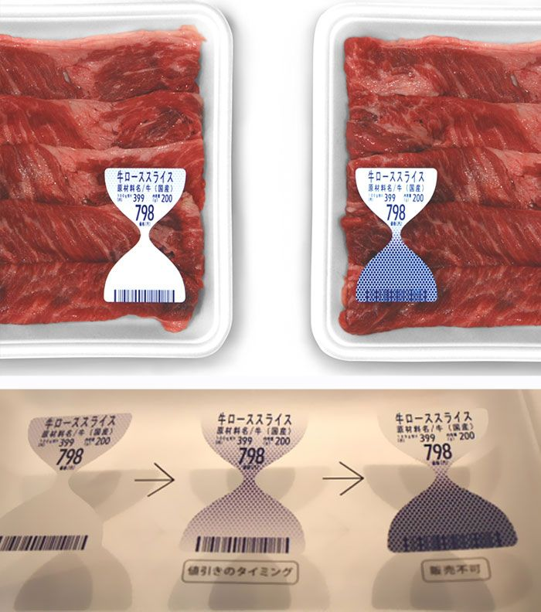
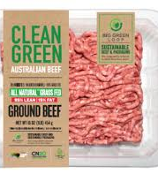
Product and service decisions
Individual product and service decisions (cont.)
Other types of product and service decisions include:
Branding
Consumers view a brand as an important part of a product, and branding can add value to a product. Customers attach meanings to brands and develop brand relationships.
Packaging
the activities of designing and producing the container or wrapper for a product
Labelling
identifies the product or brand,
describe the product – who made it, where it was made, when it was made, its contents, how it is to be used and how to use it safely
promote the brand, support its positioning and connect with customers
Product support services.

Slide 16
The rise of services marketing
The service sector substantially influences most Western economies
Increasingly, the provision of services as a complement to products is regarded as an important source of differentiation and competitive advantage
In Australia, services account for:
70% of economic activity
85% of employment
20% of exports
Services involve a deed, a performance or an effort that cannot be physically possessed
Its production may or may not be tied to a physical product

Slide 17
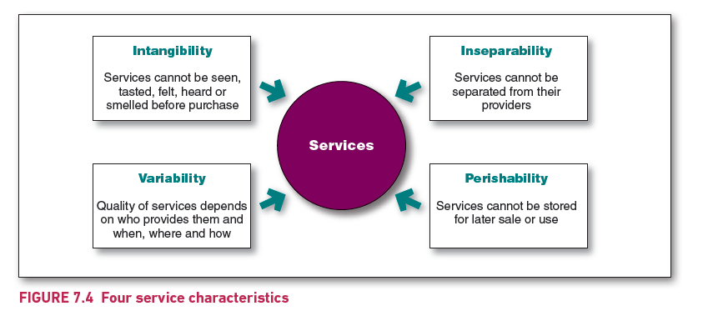
Four service characteristics
A company must consider four special service characteristics when designing marketing programs:
Notes:
The four characteristics all point to a circle in the centre labelled as 'Services’.
The four characteristics are as follows:
Intangibility: Services cannot be seen, tasted, felt, heard or smelled before purchase.
Inseparability: Services cannot be separated from their providers.
Perishability: Services cannot be stored for later sale or use.
Variability: Quality of services depends on who provides them and when, where and how.

Slide 18
Services marketing
Marketing strategies for service firms
Service firms establish their positions through traditional marketing mix activities.
However, as services differ from tangible products, they often also require additional marketing approaches beyond using the four Ps.
Successful service companies focus their attention on both their customers and their employees.

Slide 19

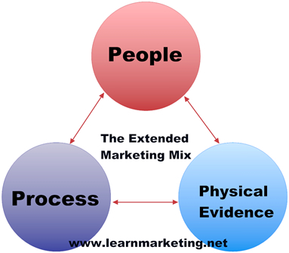
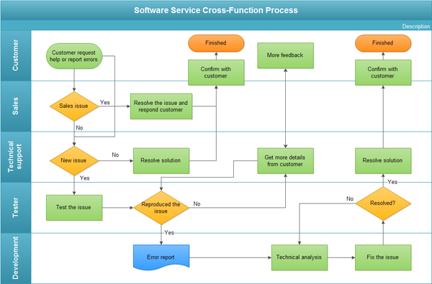

Seven elements of the ‘services’ marketing mix
There are usually regarded as three extra elements in the ‘services’ mix, over and above the usual ‘4 P’s’ …..
PROCESS: The very many service interactions between the customer and different aspects of the service provision can often be flowcharted, including identifying all the roles, training needed, costs, timing and ‘fail points’ to avoid
PEOPLE: Your personnel are the lifeblood of a service
PHYSICAL EVIDENCE: Having a physical presence to back up the service

Slide 20
New-product development strategy
A business can obtain new products in two ways:
One is through acquisition – by buying a whole company, a patent or a licence to produce someone else’s product.
The other is through the firm’s own new-product development efforts.
New-product development refers to the development of
original products – Inventions, new to the world e.g., technology (internet enabled TV, Pharmaceuticals - vaccines
product improvements – existing products made better
product modifications – line extensions in the firm's current market e.g., Carlton introducing a mid strength beer
new brands through the company’s own research and development (R&D) efforts e.g., Toyota introducing Lexus.

Slide 21
The importance of new products
New products are important to sustain growth, increase revenues and profits and replace obsolete items.
For example, Procter and Gamble (P & G) spend a considerable amount of money each year developing new products. They have:
8000 employees,
1000 holders of PhDs
26 innovation facilities around the world
2022 – spent $2 billion on R & D (Research and Development).

Slide 22
The main steps in new-product development (NPD)
Marketing
Strategy
Business
Analysis
Concept
Development
and Testing
Product
Development
Idea
Screening
Test
Marketing
Idea
Generation
Commercialisation

Slide 23
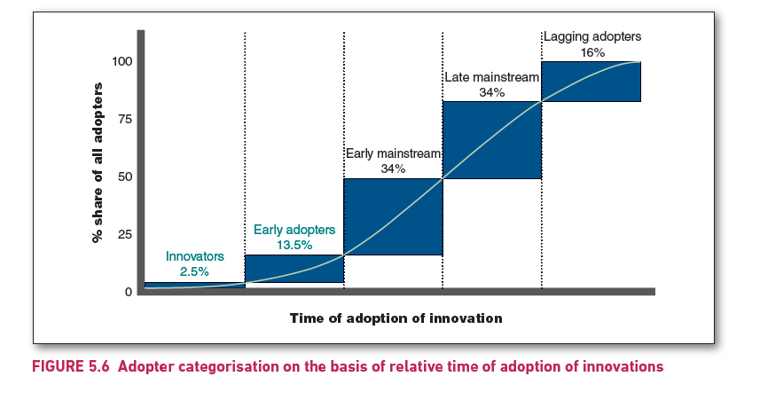
Adopter categorisation on the basis of relative time of adoption of innovations
People can be classified into five groups of adopters:
innovators – are venturesome
early adopters – are opinion leaders in their communities
early majority – are rarely leaders but adopt new ideas before the average person
late majority – are skeptical
laggards – are tradition-bound.
Notes:
Horizontal axis plots time of adoption of innovation, while vertical axis plots percentage share of all adopters, ranging from 0 to 100 in increments of 25.
Graph shows a line which rises with an upward slope, before hitting a plateau. Five points are marked on the line, with vertical and horizontal lines drawn through them to form five sections.
The five sections represent five classes of consumers and their relative percentage share, shown as follows from bottom to top, and left to right: Innovators: 2.5 per cent; Early adopters: 13.5 per cent; Early mainstream: 34 per cent; Late mainstream: 34 per cent; Lagging adopters: 16 per cent.

Slide 24
The buyer decision process for new products
Influence of product characteristic on rate of adoption
Relative advantage
(superiority over existing products)
Compatibility
(with consumer’s lifestyle, beliefs and attitudes)
Complexity
(ease of understanding)
Divisibility
(the ability to undertake limited scale trial)
Communicability
(the ability to observe and understand the innovation’s benefits or results)
Other factors:
uncertainty, social approval, risks and costs

Slide 25
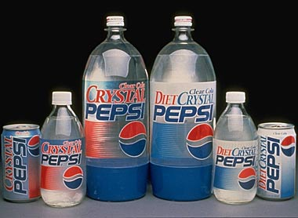
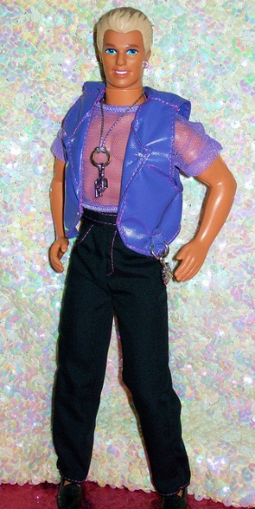
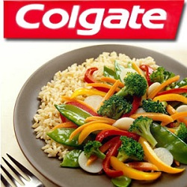
New product failure
New products fail at a rate of around 80%
Overestimated market size
Poor market research
Poor design or performance
Priced too high
Poorly advertised
Higher than expected development costs
Competitors fought back harder than expected

Slide 26
Product life-cycle strategies
The product life cycle is the course of a product’s sales and profits during its lifetime. It involves five distinct stages:
Product development – Begins when the company finds and develops a new product ideas, no profits and high investment costs
Introduction – Slow sales growth but non-existent profits due to expense of introduction to the market
Growth – A period of rapid market acceptance and increasing profits. Many competitors enter the market, large companies may start acquiring small pioneering organisations and profits are healthy
Maturity – A period of slowdown in sales growth and a levelling off or decline in profits
Decline – Both sales and profits fall off as customers switch to new products

Slide 27
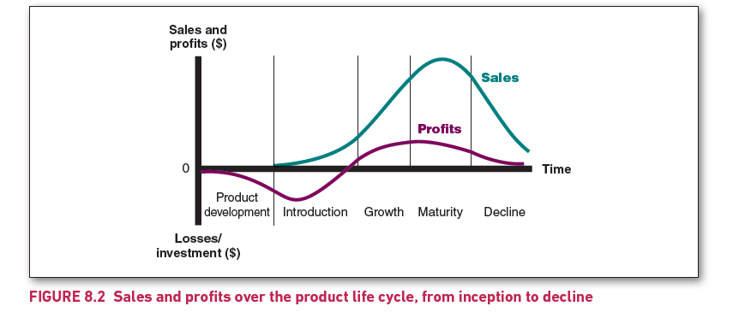
Sales and profits over the product life cycle, from inception to decline
Notes:
Vertical axis plots Sales and profits increasing, when moving in upward direction, and Losses and investments, when moving in downward direction. Horizontal axis plots time.
Four vertical lines divide the graph into five zones which depict five stages of the product life cycle. These five stages are labelled as: Product development, Introduction, Growth, Maturity and Decline, as we move from left to right.
The graph plots two curves. The curve representing Profits goes downward into the Losses/investment zone in the Product development stage, reaches a minimum in the Introduction stage, rises up thereafter to reach the horizontal axis in the Growth stage, achieves a peak at the vertical line depicting the meeting point of the Growth and Maturity stages only to decline as it moves towards the right, and finally slopes down to touch the horizontal axis in the last stage, Decline.
The second curve representing Sales starts in the second stage, Introduction, and rises steadily, then shows a rapid rise in the Growth stage, reaches a peak and begins to decline in the Maturity stage, and finally slopes down to reach a low point in the Decline stage.

Slide 28
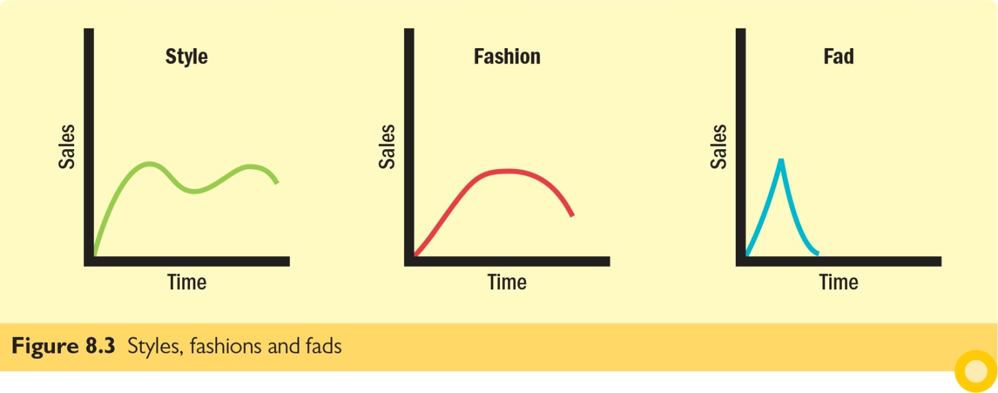
Product life-cycle strategies
The product life-cycle (PLC) concept can also be applied to each of the following:
Style – A basic and distinctive mode of expression
Fashion – A currently accepted or popular style in a given field
Fad – A fashion that enters quickly, is adopted with great zeal, peaks early and declines quickly

Slide 29

PLC Challenges
However, there are problems such as:
Identifying which stage the product is in
Pinpointing when a product moves from one stage to another and
Determining what moves the product through the stages

Slide 30
Summary of product life-cycle characteristics, objectives and strategies
Characteristics | Introduction | Growth | Maturity | Decline
Sales | Low sales | Rapidly rising sales | Peak sales | Declining sales
Costs | High cost per customer | Average cost per customer | Low cost per customer | Low cost per customer
Profits | Negative | Rising profits | High profits | Declining profits
Customers | Innovators | Early adopters | Middle majority | Laggards
Competitors | Few | Growing number | Stable number beginning to decline | Declining number
Marketing objectives
 | Create product awareness and trial | Maximise market share | Maximise profit while defending market share | Reduce expenditure and ‘milk’ the brand

Slide 31
Summary of product life-cycle characteristics, objectives and strategies
 | Introduction | Growth | Maturity | Decline
Strategies
Product | Offer a basic product | Offer product extensions, service warranty | Diversify brand and models | Phase out weak items
Price | Use cost-plus | Price to penetrate market | Price to match or beat competitors’ | Cut price
Distribution | Build selective distribution | Build intensive distribution | Build more intensive distribution | Go selective: Phase out unprofitable outlets
Advertising | Build product awareness among early adopters and dealers | Build awareness and interest in the mass market | Stress brand differences and benefits | Reduce to level needed to retain hard-core loyals
Sales promotion | Use heavy sales promotion to entice trial | Reduce to take advantage of heavy consumer demand | Increase to encourage brand switching | Reduce to minimal level
Source: Based on Philip Kotler & Kevin Lane Keller, Marketing Management, 15th edn, Pearson Education: Hoboken, NJ, 2016, p. 358. © 2016. Printed and electronically reproduced by permission of Pearson Education, Inc., Hoboken, New Jersey.

Slide 32
Additional product and service considerations
Product decisions and social responsibility
Marketers should carefully consider public policy issues and regulations regarding:
Acquiring new products
the government may prevent companies from adding products through company acquisitions if the result threatens to lessen competition.
Dropping products
must be aware they have legal obligations, written or implied, to their suppliers, dealers and customers who have a stake in the dropped product
Patent protection
A company cannot make its product illegally similar to another company’s established product.

Slide 33
Additional product and service considerations
Product decisions and social responsibility
Product quality and safety
Manufacturers must comply with specific laws regarding product quality and safety.
The laws and regulations protect consumers from unsafe food, pharmaceuticals and cosmetics.
Various Acts provide for the inspection of sanitary conditions in the meat- and poultry-processing industries.
Safety legislation has been passed to regulate fabrics, chemical substances, automobiles, toys, pharmaceuticals and poisons.
product risk and liability
If consumers have been injured by a product that has a defective design, they can sue the manufacturers or dealers.
Product liability lawsuits can be very costly for businesses.

